Slide 1
Writing to Support - Reference
Chapter Four
Fatima M.AbuHjeela

Slide 2
Writing to Support
This is also referred to as Support Documentation, includes all the look-up sections and elements of your manuals and help. It takes forms like:
Command descriptions
Menu overviews
Lists of definitions
Function descriptions
Examples
Error messages
Fatima M.AbuHjeela

Slide 3
Writing to Support
It associated with advanced users:
users who know the software well , but need to look up specific elements of it that are too complicated to memorize .
You should study ways to design reference information in task-oriented way.
Electronic and hypertext-based interfaces allow writers to design online documents that use powerful and useful technology for looking up information and relating it to workplace actions and purpose.
Fatima M.AbuHjeela

Slide 4
Reference Guidelines
1- Choose the Right Form of Reference
Reference user know the interface and usually come looking for a specific piece of data to complete some task they themselves have defined .

Slide 5
1- Choose the Right Form of Reference
1- Appendices:
It often contains some of the most valuable information relating to the use of the program.
It allow documenters to put all highly detailed, technical information that highly detailed, technical persons would want and use in the workplace.
Print appendix contains information that’s relevant and useful , but not essential to all users.
Appendix in software manual may contains:
- Error messages.
- Filenames and extensions.
- Troubleshooting tips.
- Matrixes of compatibility with other programs.
- ASCII charts showing word processor key-combination.
- Printer driver charts showing capabilities with various printer brands.
Fatima M.AbuHjeela

Slide 6
1- Choose the Right Form of Reference
2- Readme Files:
Text files that accompany programs on the distribution disk or come when you download the software from an internet site.
It contains the following kinds of information:
  Installation details.
  Last minute changes that are not included in a manual.
  New features in a recent release.
  File descriptions .
  Compatibility requirements with other programs.
  Etc.
Fatima M.AbuHjeela

Slide 7
1- Choose the Right Form of Reference
3- Job Aids (Job Performance Aids) :
These are shorter forms of reference documentation that includes definitions, brief processes, command summaries etc.
These are for people who already have basic training with the software.
It is “ repository for information ,processes, or perspectives that is external to the individual and that supports work and activity by directing ,guiding performance.
Fatima M.AbuHjeela

Slide 8
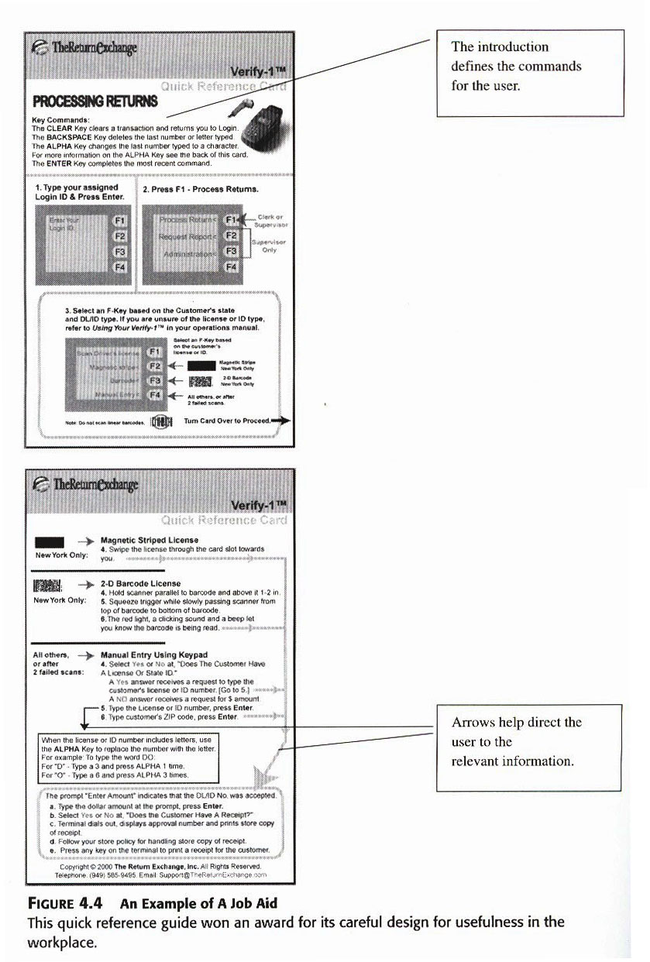
Fatima M.AbuHjeela

Slide 9
1- Choose the Right Form of Reference
4-Innovative Forms : Flipcards
Type of documentation that are presented in special formats, such as foldouts, posters, and flip-cards.
The advantages of special formats like flip-cards are :
  Improve readability.
  Contain a lot of information.
  Make information more accessible.
  Use elements like color to help locate information
Fatima M.AbuHjeela

Slide 10
2- Decide What to Include
You can include the following information in the reference section:
1- Commands :
Refer to all the instructions used to work with a program.
These include meanings of special function groups, explanations of set commands, definitions of format commands, instructions for using utilities, explanations of toolbars, and definitions of macros.
2- Interface Elements :
It refers to the part of screen or command line of screen regions, and explanations that the user sees and has to read and manipulate in order to put the program to work.
Information about interface elements would include the following: explanations of menus, definitions of keys, labels of rulers.
Fatima M.AbuHjeela

Slide 11
2- Decide What to Include
3- Definition of Terms (Glossary):
It contains definitions of terms that the user finds in the manual and needs to understand in order to work the program.
There are two kinds of glossary items:
  Concepts that underlie the software.
  Examples: masks, shell, routers and so forth.
  Terms relating to the subject matter of the software.
  Examples: general ledger,gutter…etc.
Fatima M.AbuHjeela

Slide 12
2- Decide What to Include
What to Include in a Single Reference Entry
The following list of possible elements divided into grouping relating to the kind of information each present to the user:
Conceptual Information :
Emphasizing the idea of the commands and its function.
Structural Information :
Emphasizing the relationship of the commands to other commands.
Technical Information:
Emphasizing the software programming associated with the command.
Fatima M.AbuHjeela

Slide 13
3- Establish a Pattern
The key to reference material lies in patterns, repeating the same set of elements over and over again ,so the user become familiar with reference .
The following topics can be included in patterns:
  1-Definition : Tell what the command or function does.
  2- Explanation : Tell how to apply the command or function.
  3- Example : Give an example of the command or function in use.
  4- Step-by-step: present abbreviated steps for using the command or function.
  5- Warning/cautions: let the user know what problems might a rise.
Fatima M.AbuHjeela

Slide 14
4- Organize the Reference Section
You have two basic choices for organizing your reference section
1- Alphabetical Organization:
Heap all the functions of the program together, regardless of the menu structure, and go through them one at a time, starting with the a‘s.
Drawback :
It does little to support the task -orientation of your manual.
Fatima M.AbuHjeela

Slide 15
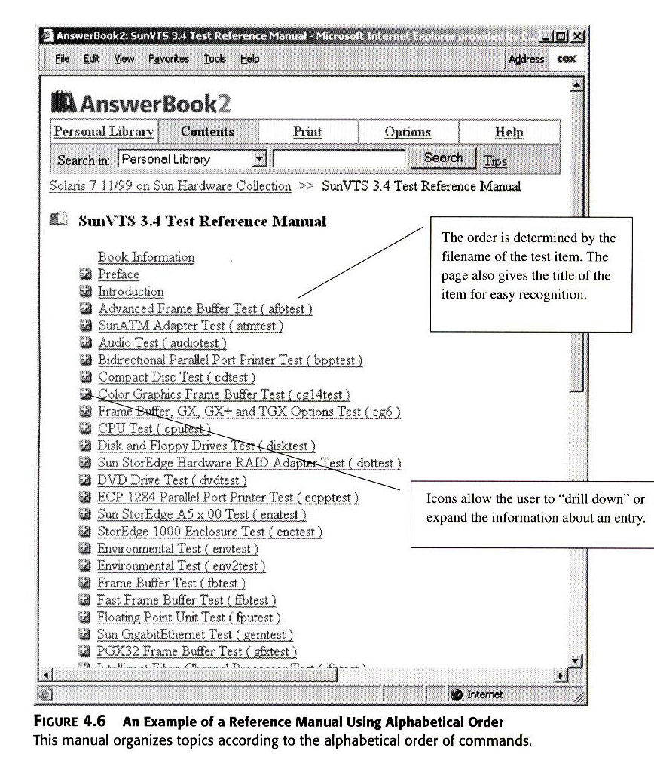
Fatima M.AbuHjeela

Slide 16
4- Organize the Reference Section
You have two basic choices for organizing your reference section :
2- Menu-by-Menu:
You set up your reference section by menu, according to how the user sees them in the program.
You start with main menu then secondary menu, present each menu, and then, in the subsequent pages, describe each of the commands in the order they appear on the menu.
The strong advantage of this is its reinforcement of the task
orientation of your work.
Fatima M.AbuHjeela

Slide 17
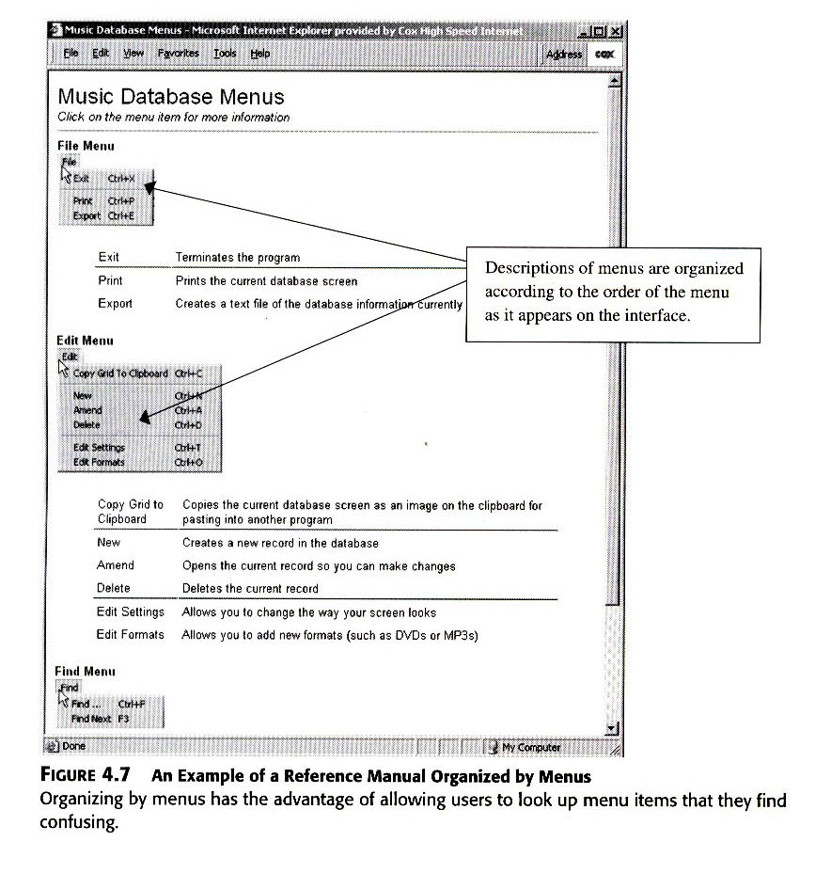
Fatima M.AbuHjeela

Slide 18
5- Show How to Use the Reference Information
In many cases, your document required no instruction. Maps of menus or summary of commands represent a self-explanatory reference page.
You should tell the user - usually- in the introduction, the pattern you intend to
follow, so he or she establish it in his/her mind, set up the right expectation, and it will serve as a reminder of how you organize each entry.
Such an introduction should explain:
1- who should use the info, which type of users.
2- how you organize the info, alphabetical or menu bye menu.
3- element of each entry, list element of each entry.
4- relation to other section of the documentation, cross reference to other parts of the document.
Fatima M.AbuHjeela

Slide 19
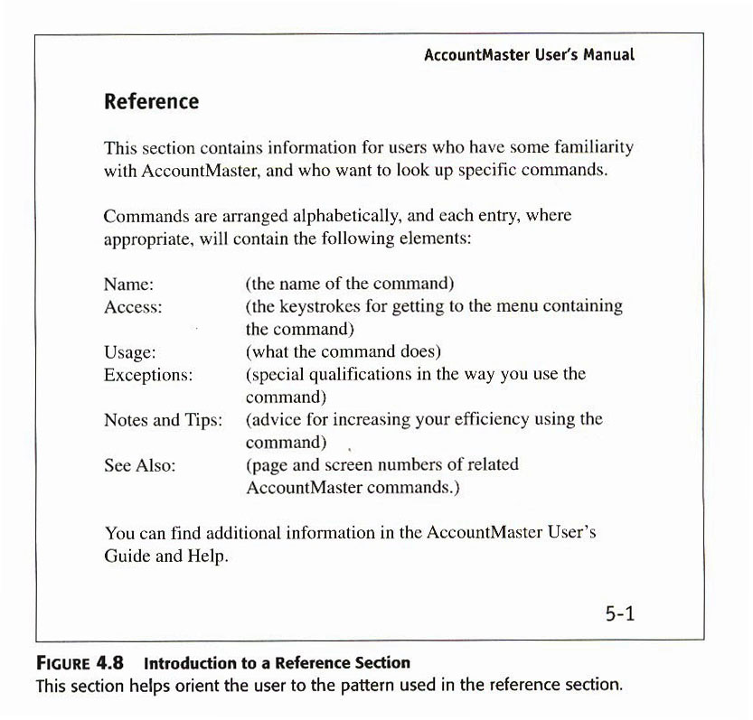
Fatima M.AbuHjeela

Slide 20
Practice and Problem Solving
Write a tool bar Reference .
Analyze Reference Formats.
Fatima M.AbuHjeela

